Slide 1
11.1.2 Software-Update
B175R
B260R
B400R/RM/RH

Slide 2
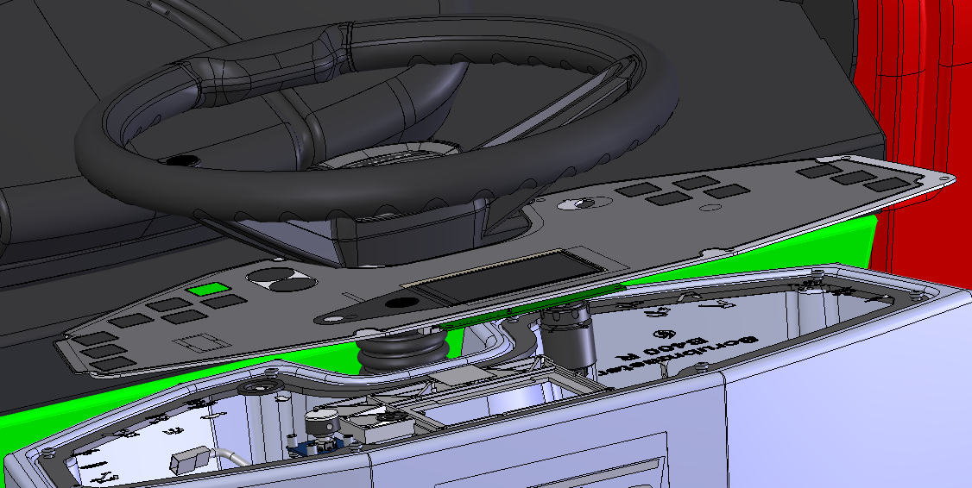
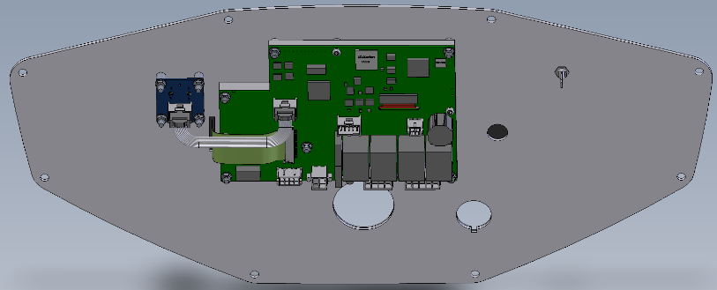
1) Flash SD-Card
The SD cardslot is on the rear side of the display board A2. For flashing, the SD card has to be extracted from the slot. To do this dismount the dash-board (8 screws). Then you could take out the card.
SD card slot
Rear side of dash board

Slide 3
SD-Card into computer SD-Slot
Only one SD drive may be connected, otherwise an error message will appear.
The Hako Diagnosis must be connected to an interface. A connection to the machine is not necessary.
Depending on whether not connected or connected follow the steps
Interface is not connected to the machine or
Interface is connected to machine

Slide 4
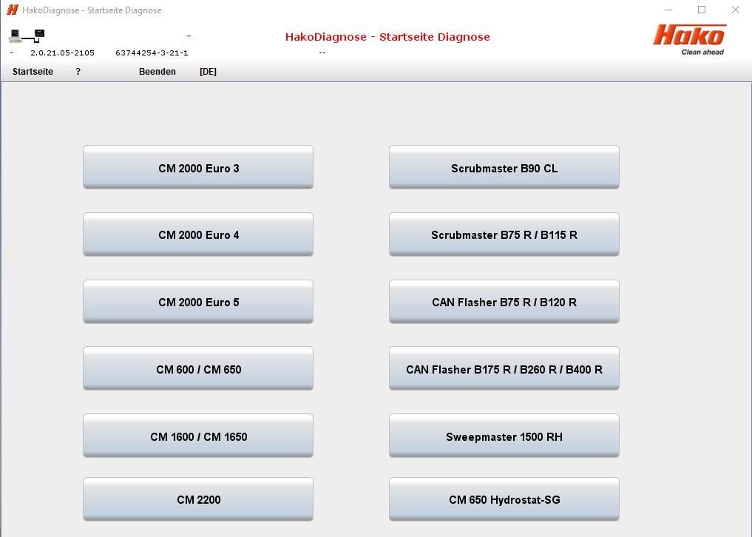
Choose “CAN Flasher B175R / B260R / B400R“ program in Hako Diagnosis.

Slide 5
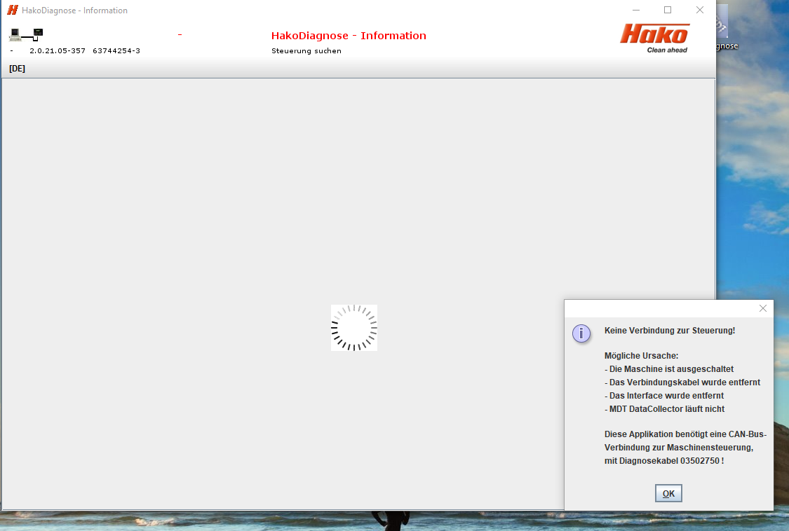
a) Interface is not connected to machine
By choosing “OK “ the search process is canceled.

Slide 6
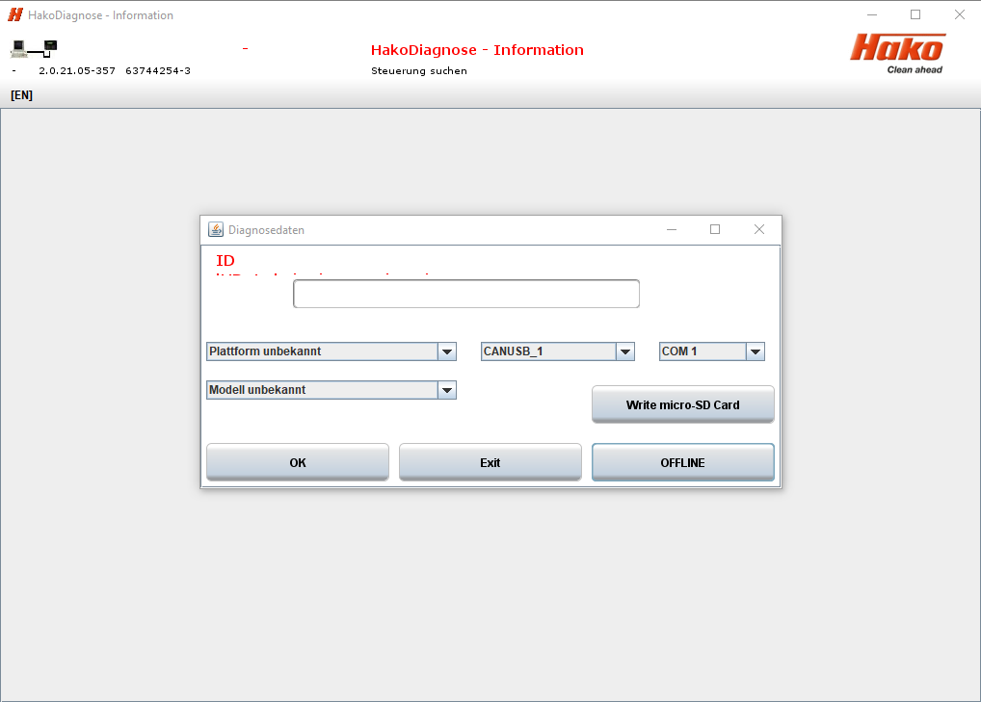
Choose “Write micro SD Card“ program.

Slide 7
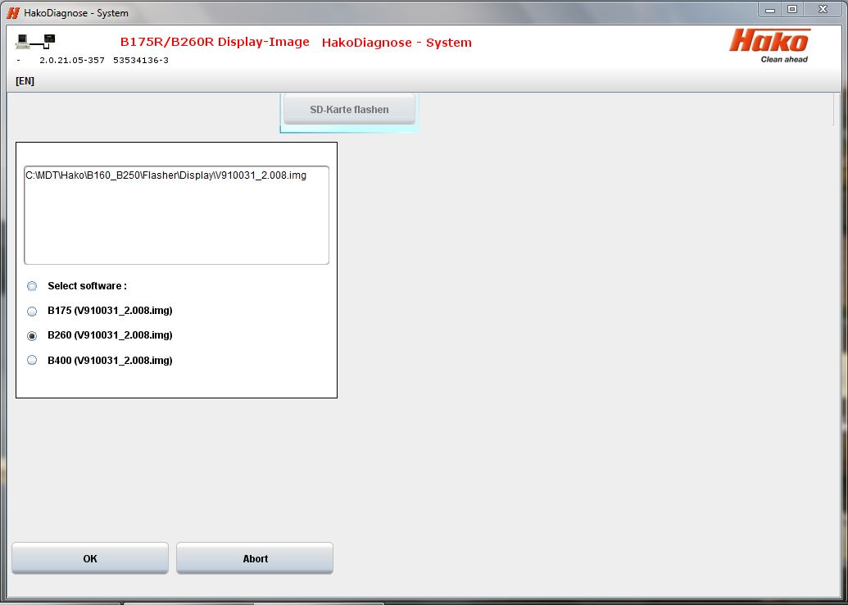
Choose corresponding machine and start flashing with “OK“.
* The software versions shown here may differ, as the document is only a snapshot

Slide 8
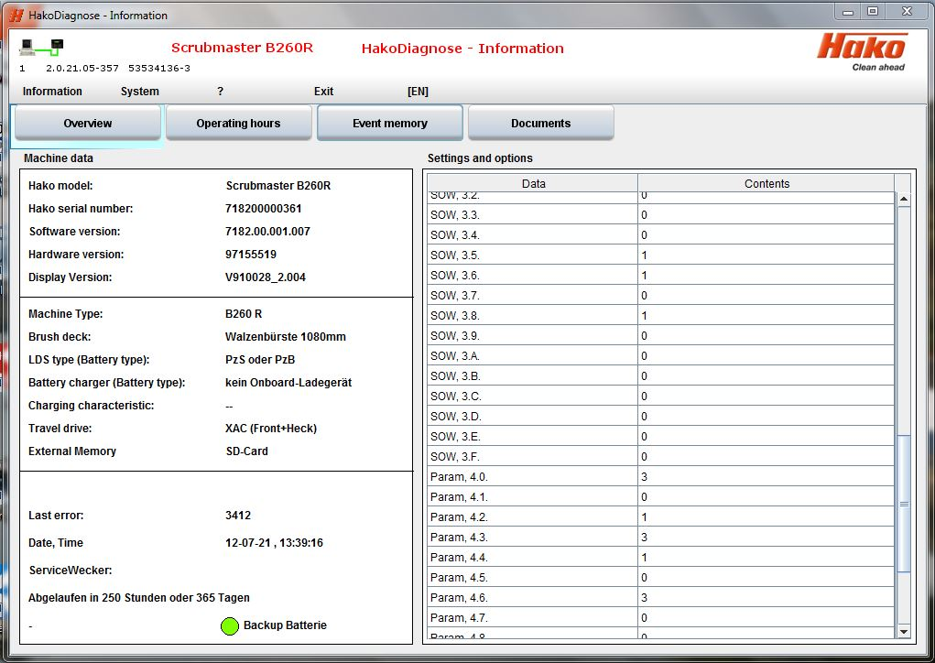
b) Interface is connected to machine (sample B260R, equal for all types)
Choose menue “System“
* The software versions shown here may differ, as the document is only a snapshot

Slide 9
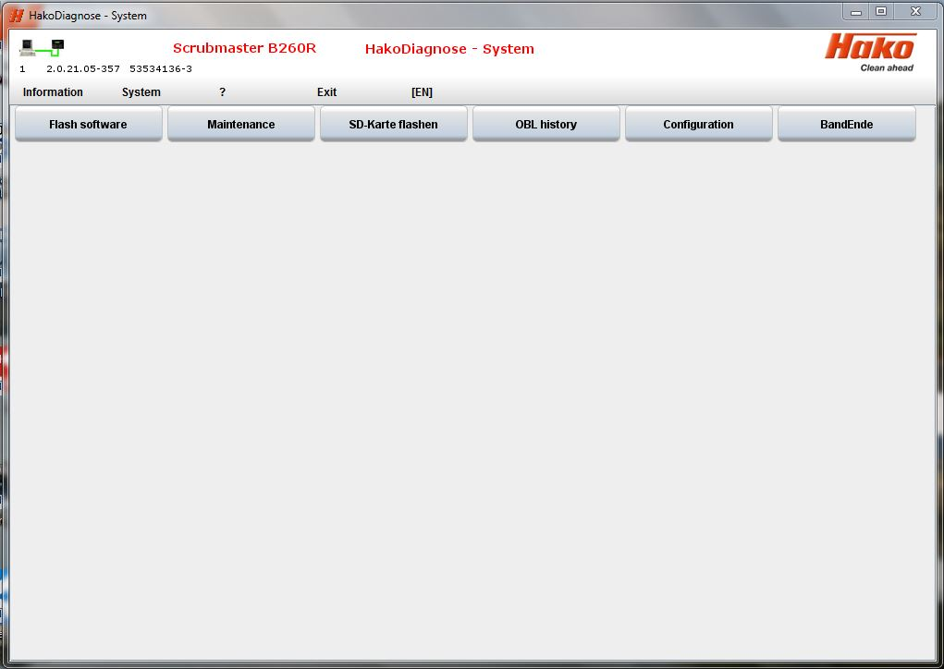
Choose the programm “SD-Karte flashen“.

Slide 10
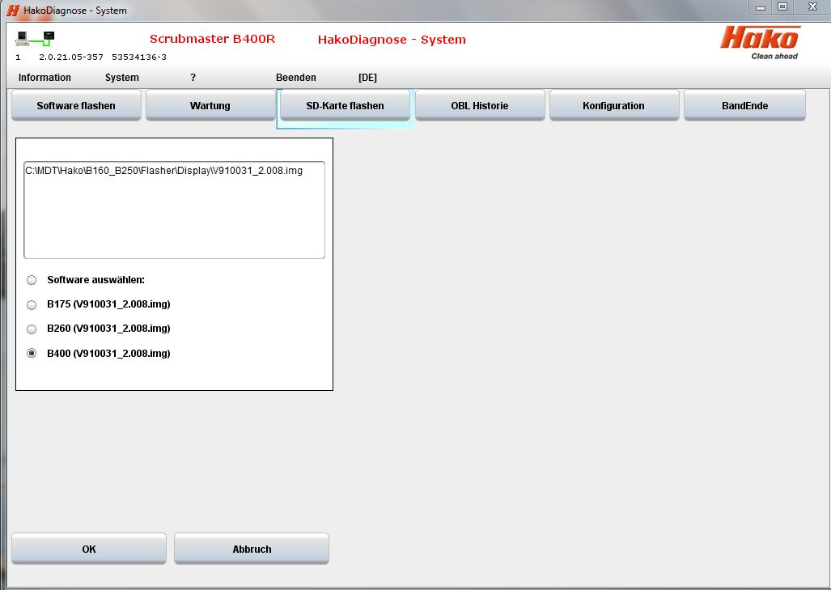
Choose corresponding machine and start flashing with “OK“.
* The software versions shown here may differ, as the document is only a snapshot

Slide 11
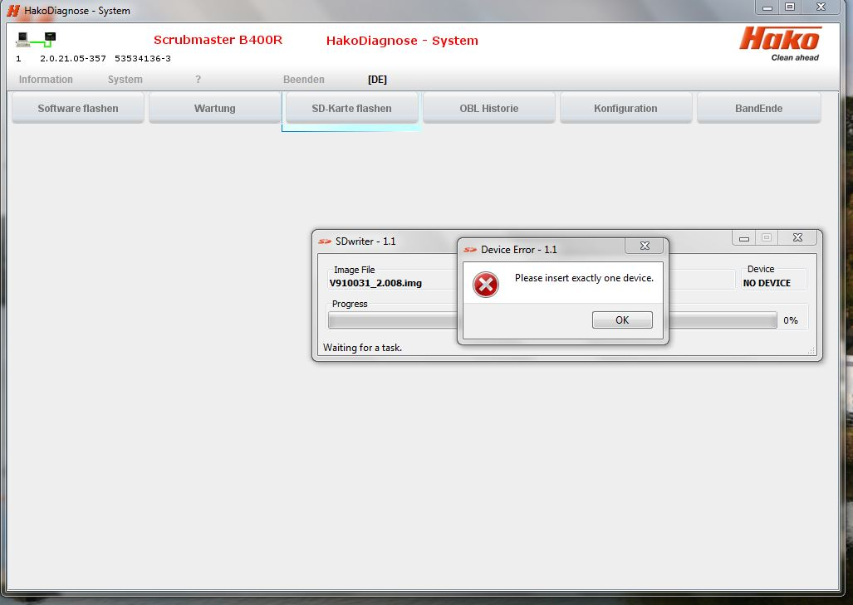
Possible error message with both variants
Message if there are problems with the SD card or the drive. The following errors are possible:
- SD card is defective
- SD drive is defective
- More than 1 SD drive is recognized
- Drive does not meet the specifications of the SD-Writer

Slide 12
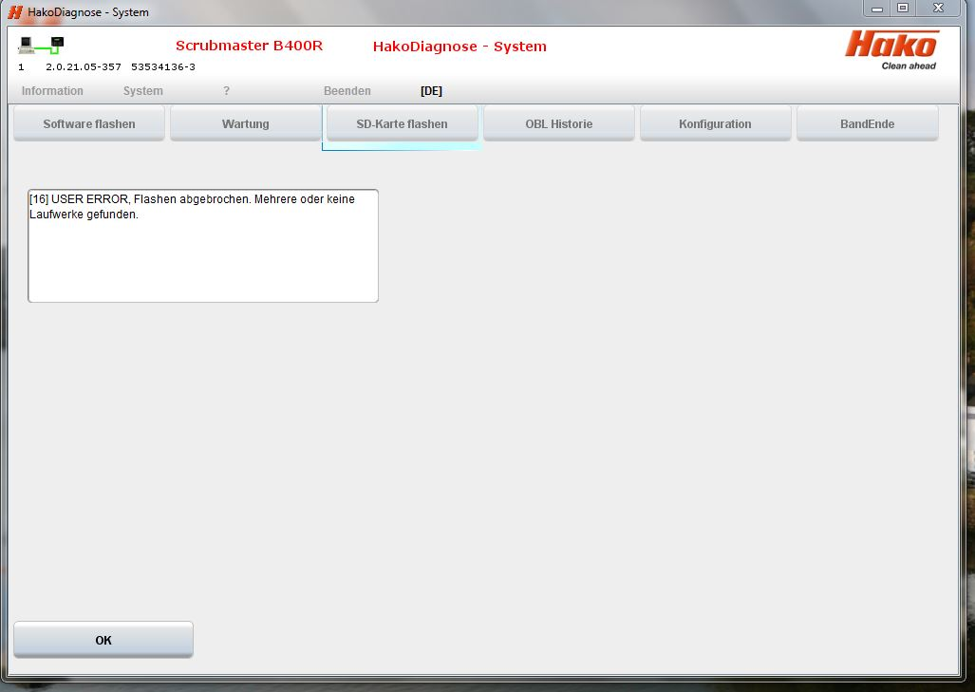
Display if the message “Please insert exactly one device“ was confirmed with OK.

Slide 13
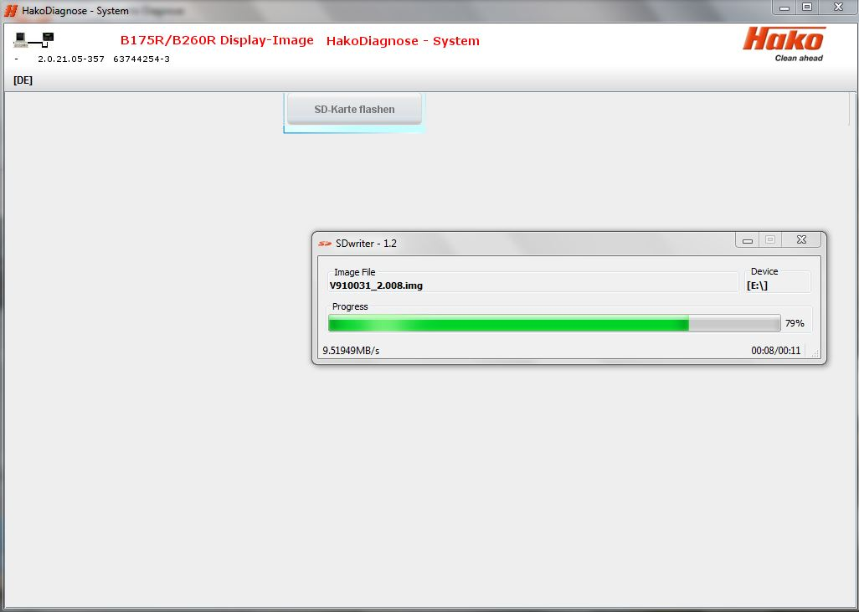
Display when the flash process has started normally

Slide 14
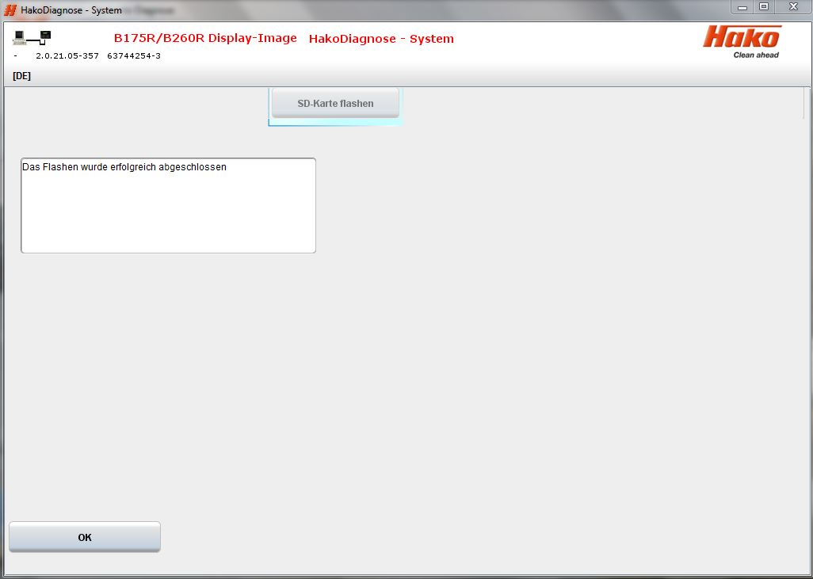
Flash process is succesfully finished. Confirm with “OK“

Slide 15
SD card back into SD-Slot of display
After the flash process is done, put the SD card back (from the computer to the display).
SD card slot
Rear side of dashboard

Slide 16
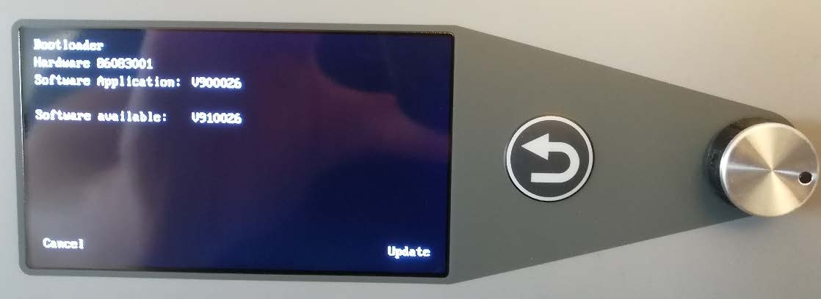
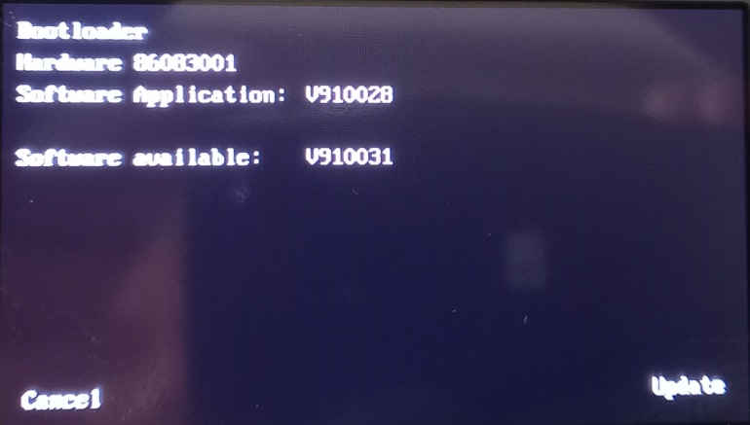
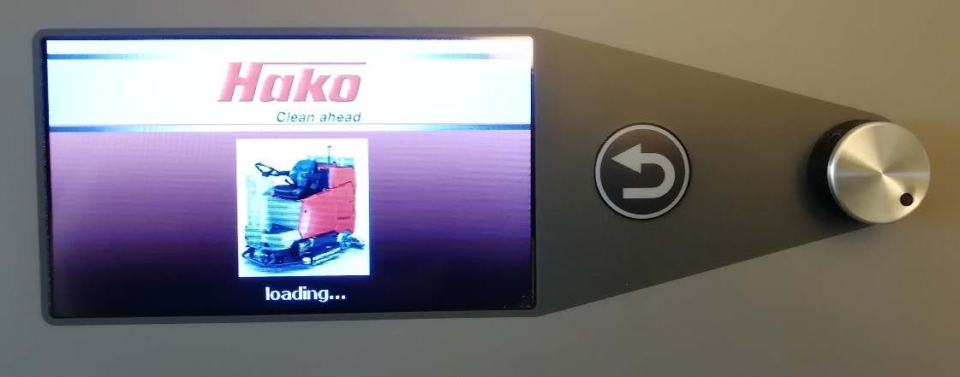
After the key switch is ON, the message of a new variant appears on the screen,
with the request “Update”. To do this, just press the rotary push button. Turning it leads to termination

Slide 17
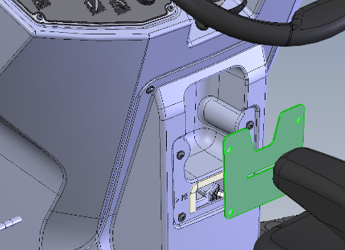
2) Flash software A1
The Hako diagnosis must be connected to an interface. A connection to the machine (OBD plug) is essential.
OBD plug
Choose “CAN Flasher B175R / B260R / B400R“ program in Hako Diagnosis.

Slide 18
Choose menue “System“ (sample B260R, equal for all types).
* The software versions shown here may differ, as the document is only a snapshot

Slide 19
Choose program “Flash software“.

Slide 20
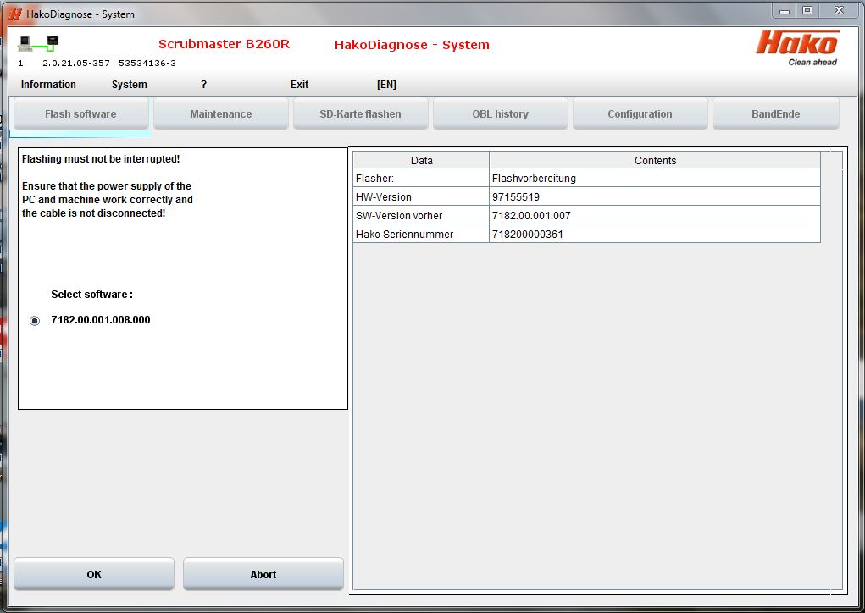
Start flash process with “OK“.
* The software versions shown here may differ, as the document is only a snapshot

Slide 21
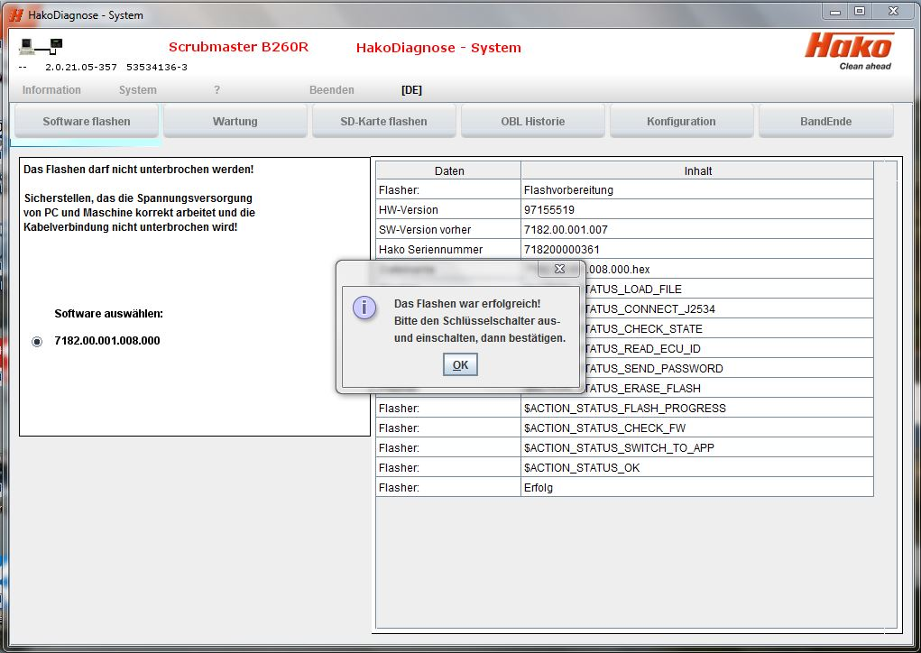
Flash process is succesfully finished. Confirm with “OK“

Slide 22
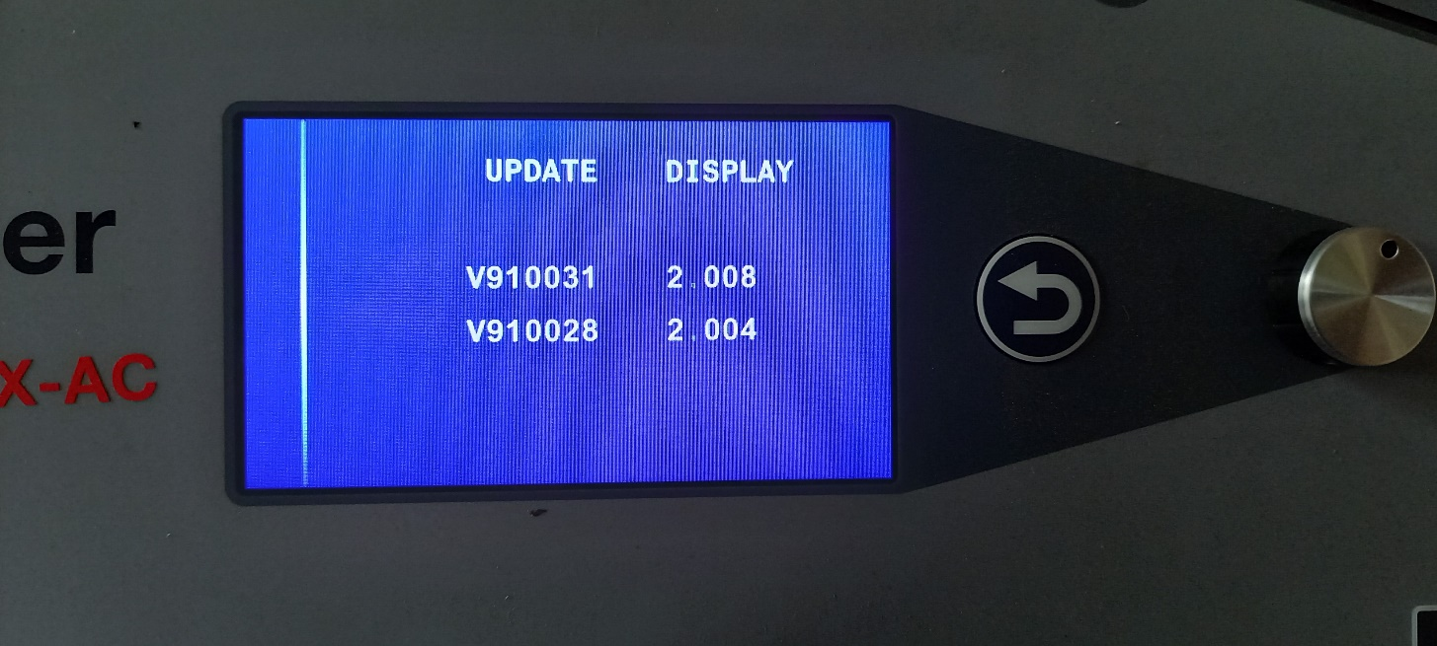
If only update software A1 is carried out. The following display appear after the key switch is ON. This means that newer display software is required
needed display software
existing display software
* The software versions shown here may differ, as the document is only a snapshot

Slide 23
3) Check software versions
Choose “CAN Flasher B175R / B260R / B400R“ program in Hako Diagnosis.

Slide 24
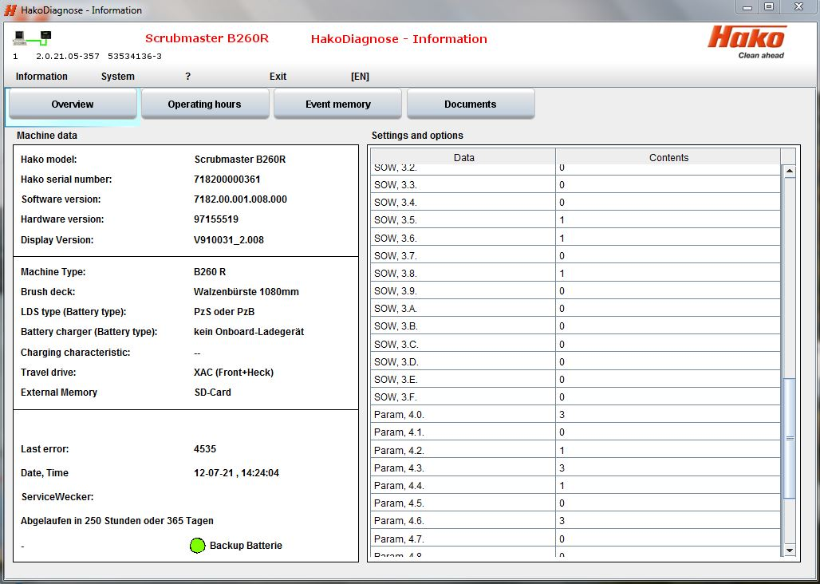
Compare the version numbers under "" Display Version: and Software Version: "with the specification (sample B260R, equal for all types)
* The software versions shown here may differ, as the document is only a snapshot

Slide 25
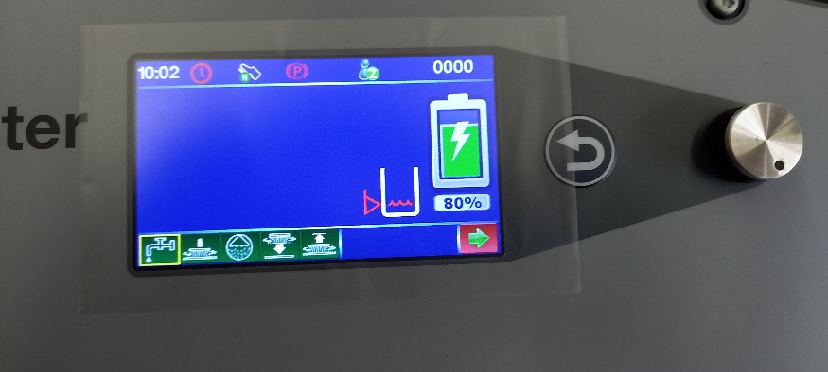
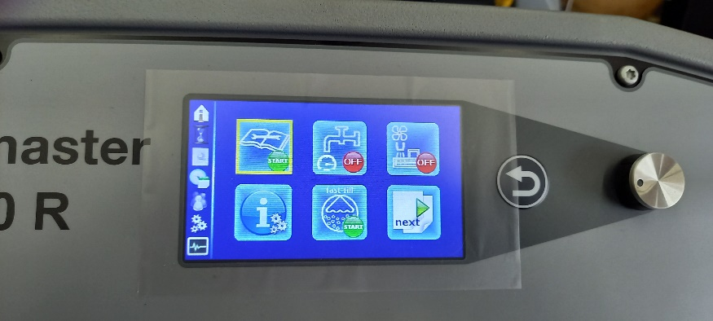
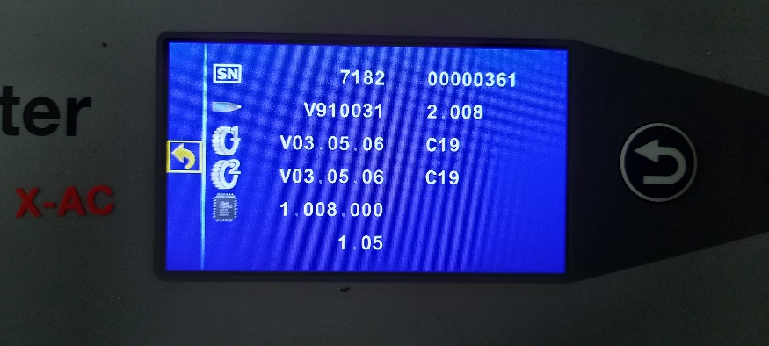
Alternative method to check versions (sample B260R, equal for all types)
“Rotate” until green arrow on red background confirm by “Pressing” rotary push button
"Rotate" until the information field is framed in yellow confirm by “Pressing” rotary push button
(sample B260R, equal for all types)
Serial number of the machine
Display version
Front wheel drive control version
Rear wheels drive control version
Main board (A1) version
Bootloader version

